Slide 1
Data Analyst Nanodegree
Session 8
Conducted by: Hamza
Notes:
https://udacity.zoom.us/j/7991233356
<number>

Slide 2
agenda
Visual vocab
Level of detail
Layouts
Shortcuts
Tailored training
Seaborn

Slide 3
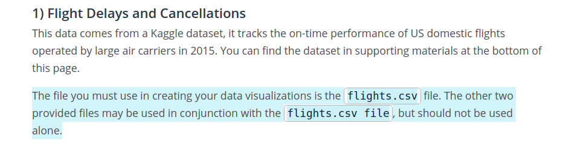
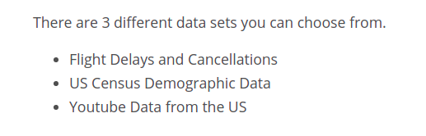
project
???!

Slide 4
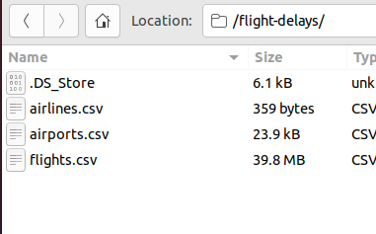
project

Slide 5
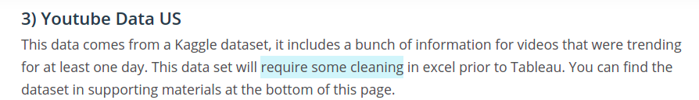
Dataset 3

Slide 6
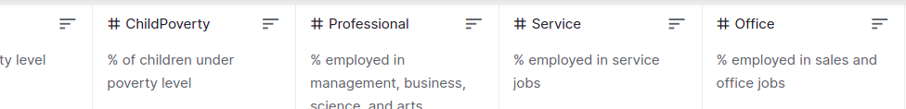
Dataset 2

Slide 7


Slide 8
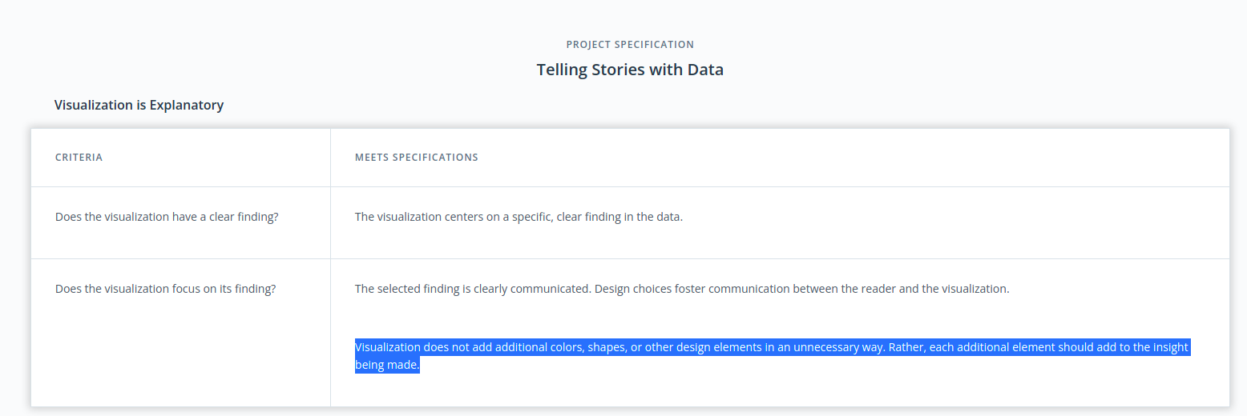
Rubric

Slide 9
https://review.udacity.com/#!/rubrics/1060/view

Slide 10
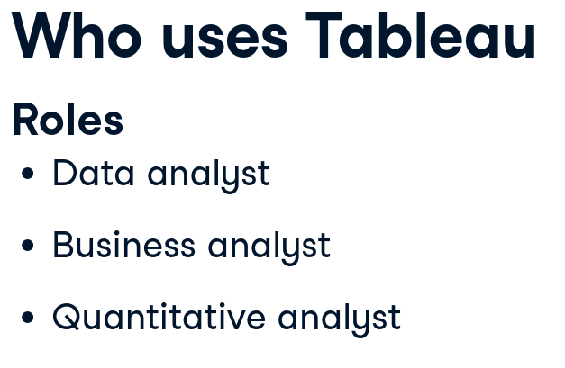

Notes:
Most common job titles
https://campus.datacamp.com/courses/introduction-to-tableau/getting-started-with-tableau?ex=1

Slide 11
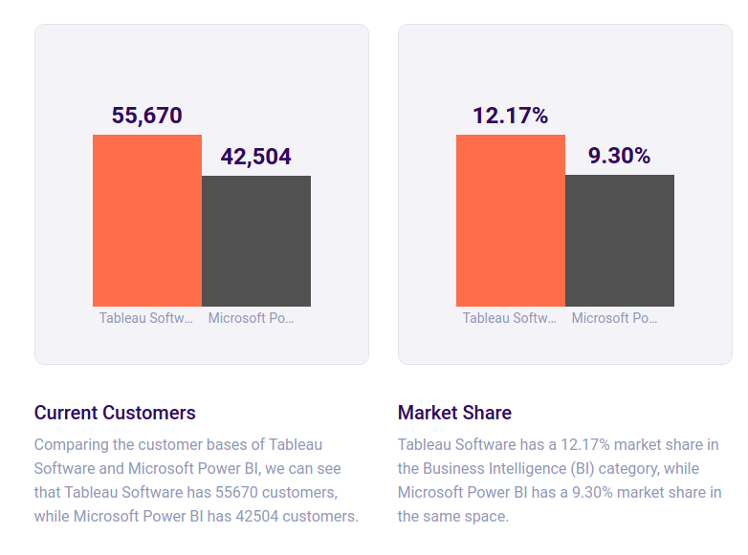
Market share (Slintel)
Notes:
https://www.slintel.com/tech/business-intelligence-bi/tableausoftware-vs-microsoftpowerbi

Slide 12
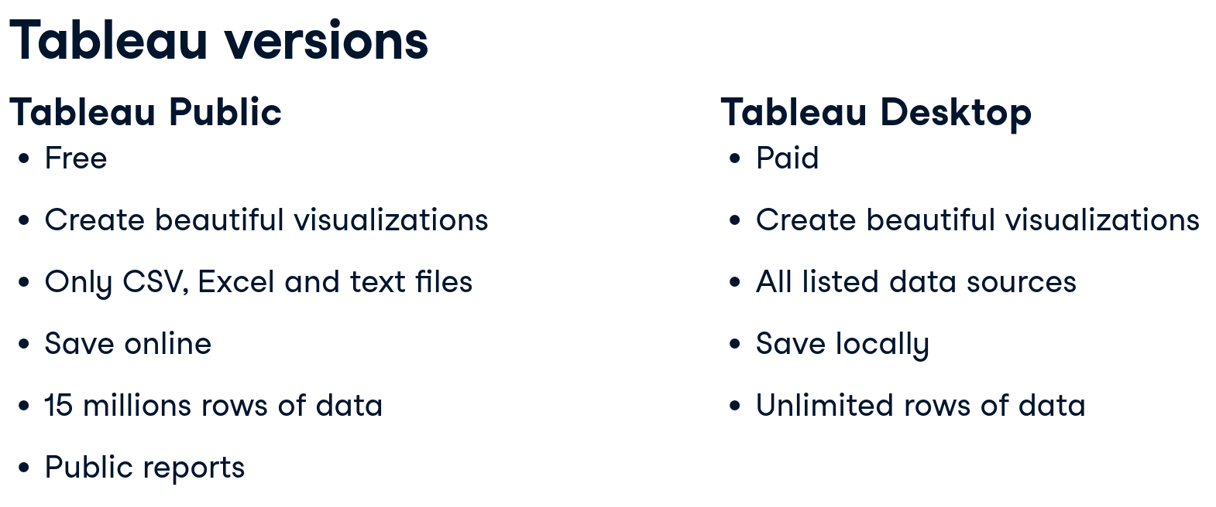
Notes:
Need to check if tableau pubic supports only these files

Slide 13
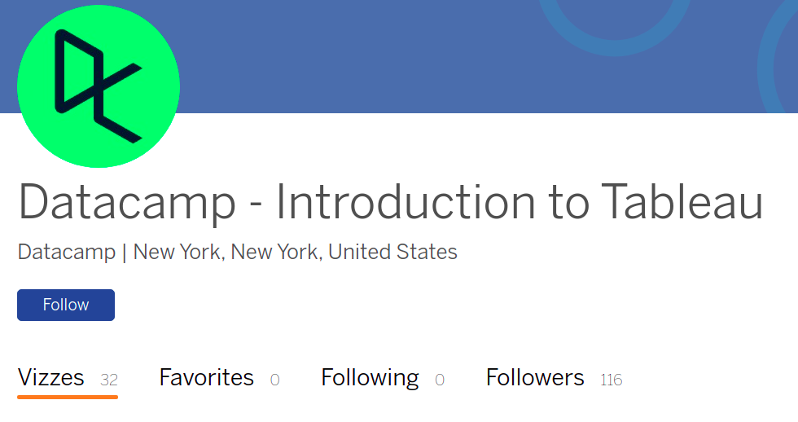
Notes:
https://public.tableau.com/app/profile/datacamp.introduction.to.tableau#!/

Slide 14
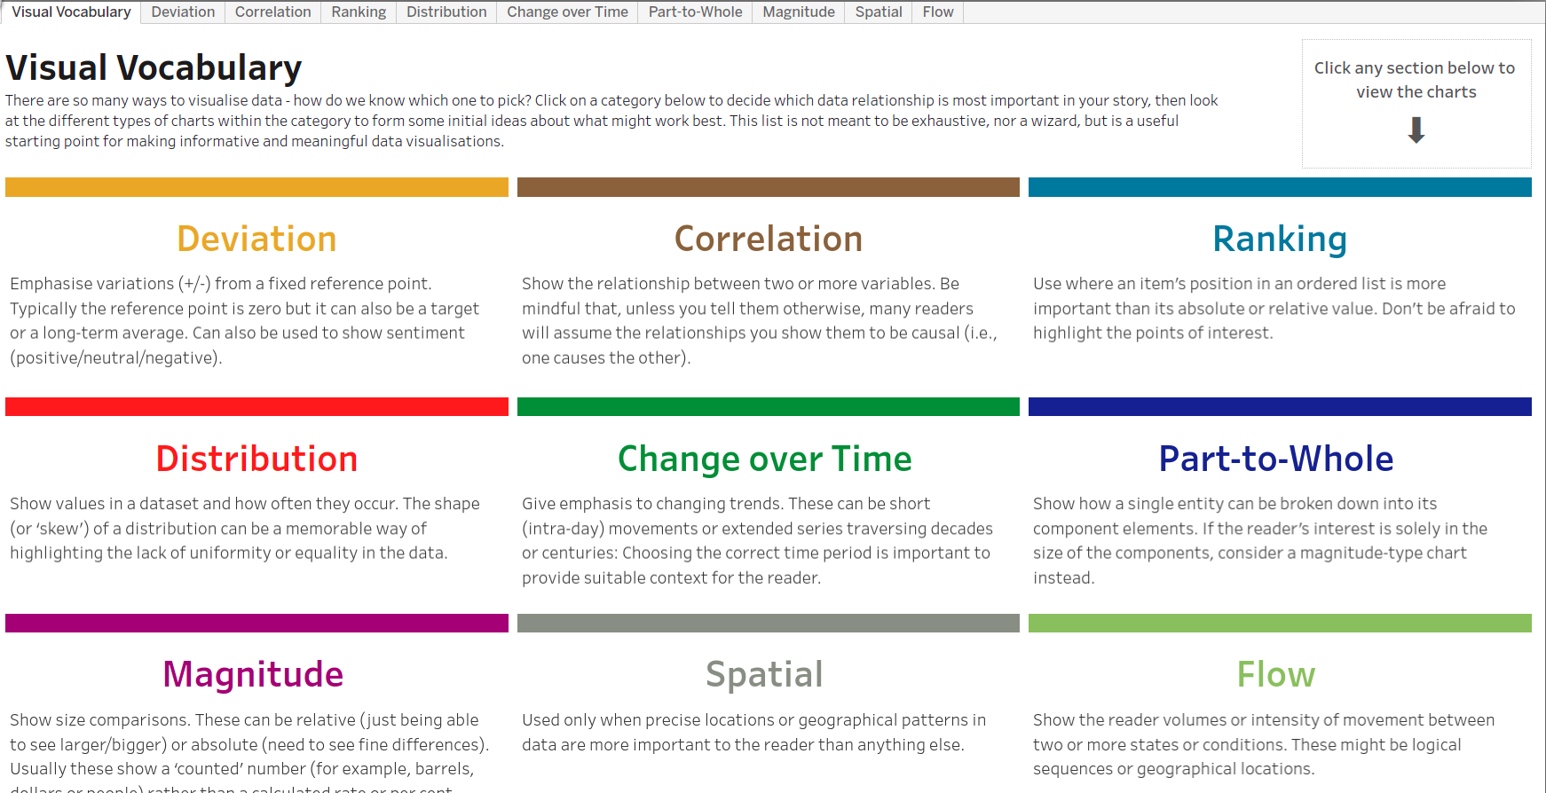
Visual vocabulary
https://public.tableau.com/views/VisualVocabulary/VisualVocabulary?%3AshowVizHome=no

Slide 15
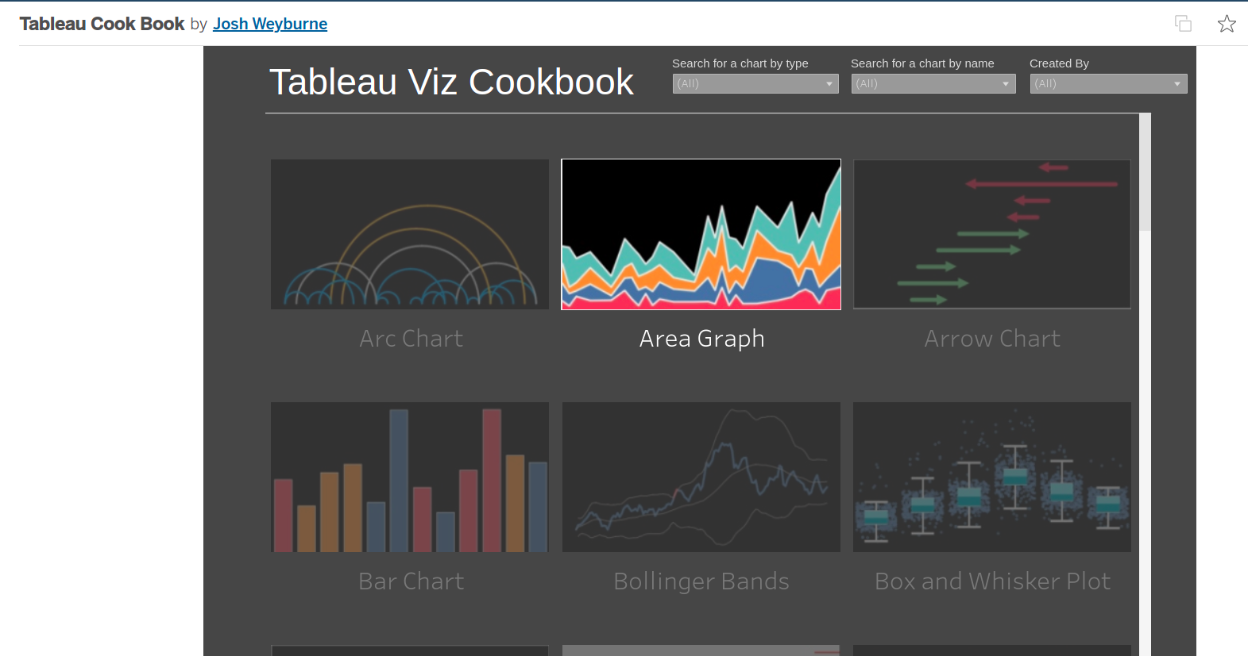
cookbook
https://public.tableau.com/app/profile/josh.weyburne/viz/CookBook/VizCookbook
Notes:
https://public.tableau.com/app/profile/josh.weyburne/viz/CookBook/VizCookbook

Slide 16
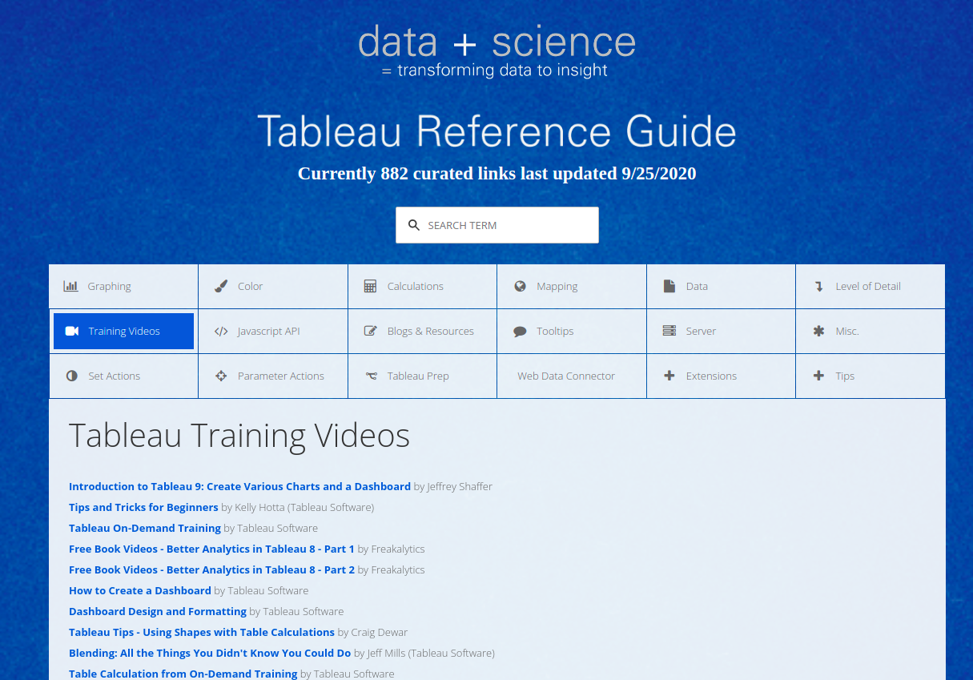
Notes:
http://www.tableaureferenceguide.com/

Slide 17
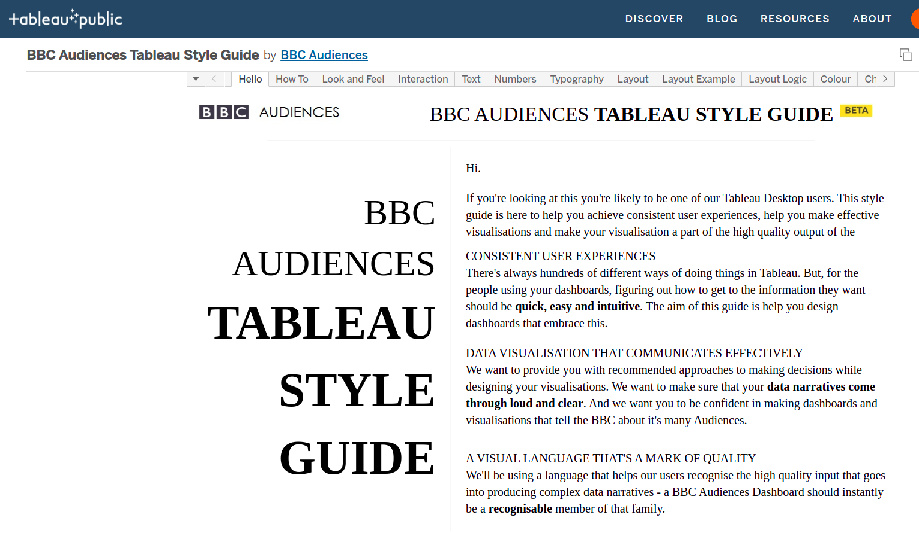
Notes:
BBC Audiences Tableau Style Guide | Tableau Public
https://public.tableau.com/app/profile/bbc.audiences/viz/BBCAudiencesTableauStyleGuide/MoreInfo2

Slide 18
Non-aggregating numerical dimensions
https://campus.datacamp.com/courses/analyzing-data-in-tableau/preparing-for-analysis?ex=2

Slide 19
Dimensions and measures
https://campus.datacamp.com/courses/introduction-to-tableau/getting-started-with-tableau?ex=6

Slide 20
Segmenting using dimensions
https://campus.datacamp.com/courses/introduction-to-tableau/getting-started-with-tableau?ex=9

Slide 21
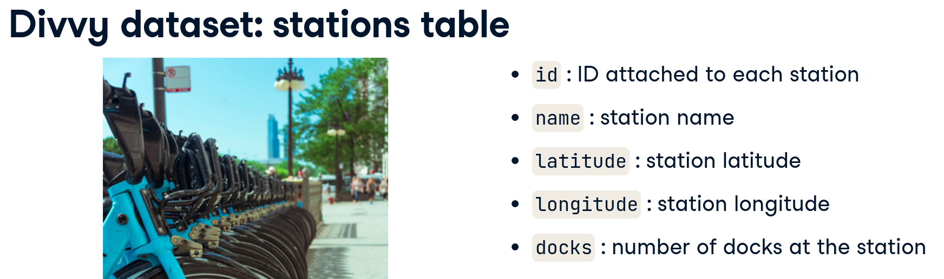
Exercise data validation

Slide 22
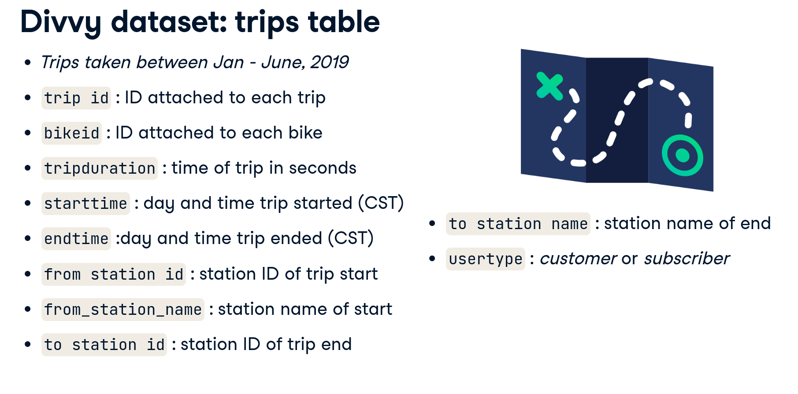
Preparing data

Slide 23
Cleaning up
https://campus.datacamp.com/courses/analyzing-data-in-tableau/preparing-for-analysis?ex=4

Slide 24
Calculating
https://campus.datacamp.com/courses/analyzing-data-in-tableau/preparing-for-analysis?ex=7

Slide 25
Slicing and dicing
https://campus.datacamp.com/courses/analyzing-data-in-tableau/preparing-for-analysis?ex=14

Slide 26
treemap
https://campus.datacamp.com/courses/analyzing-data-in-tableau/preparing-for-analysis?ex=16
Nice exercise

Slide 27
Solve it ur way
https://campus.datacamp.com/courses/analyzing-data-in-tableau/preparing-for-analysis?ex=18

Slide 28

Datacamp course
https://app.datacamp.com/learn/courses/case-study-analyzing-customer-churn-in-tableau

Slide 29
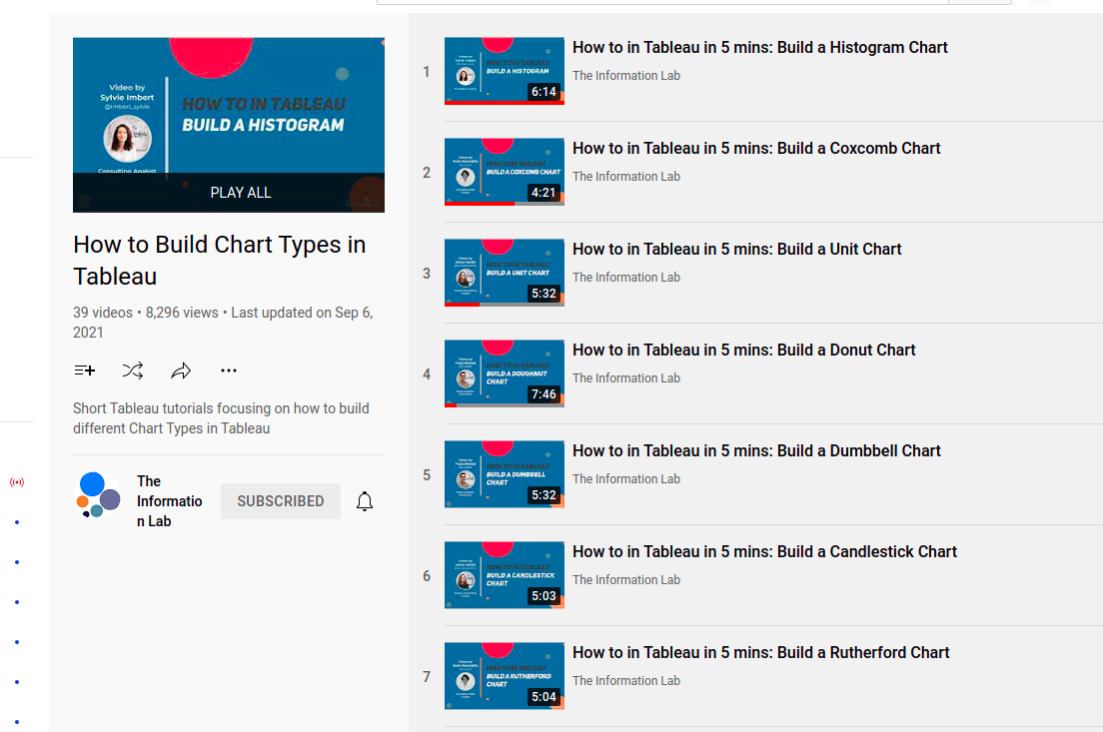
How to?
https://www.youtube.com/playlist?list=PL_t5OlLHbVGxFSiWXUsEQrDPvFd1Nhxiu

Slide 30
KimberlyFessel
https://www.youtube.com/watch?v=uZlMNUPA26E

Slide 31

Tailored training
https://www.tableau.com/learn/learning-quiz

Slide 32
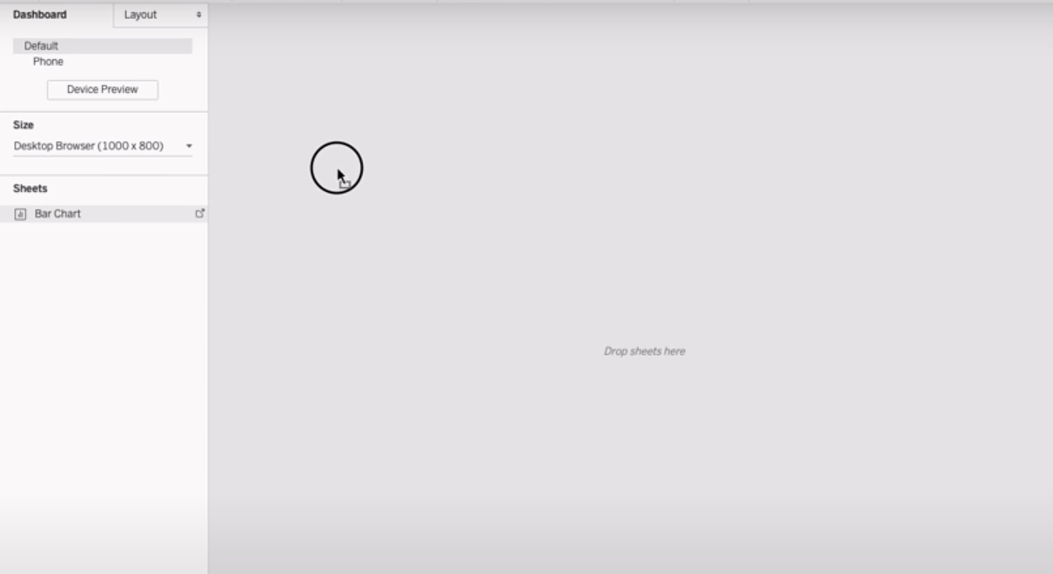
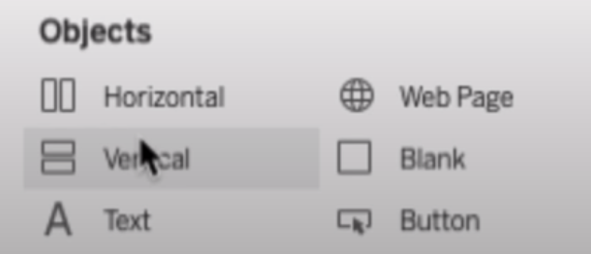
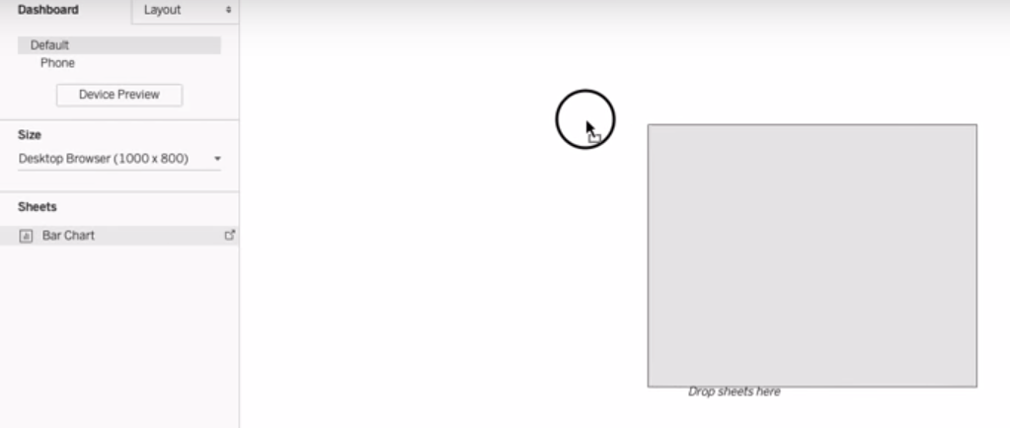
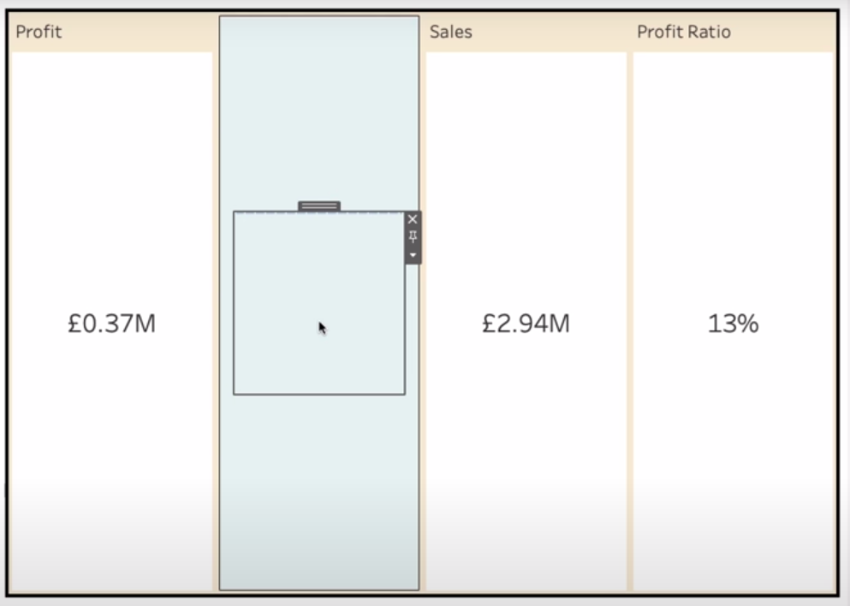
Dashboard layout

Slide 33
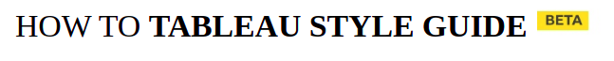
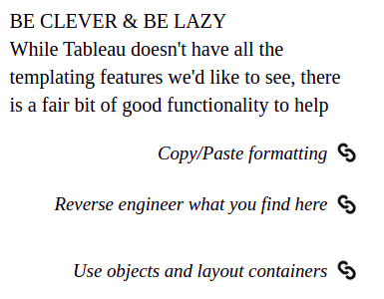
https://public.tableau.com/views/BBCAudiencesTableauStyleGuide/HowTo?%3Aembed=y&%3AshowVizHome=no&%3Adisplay_count=y&%3Adisplay_static_image=y

Slide 34
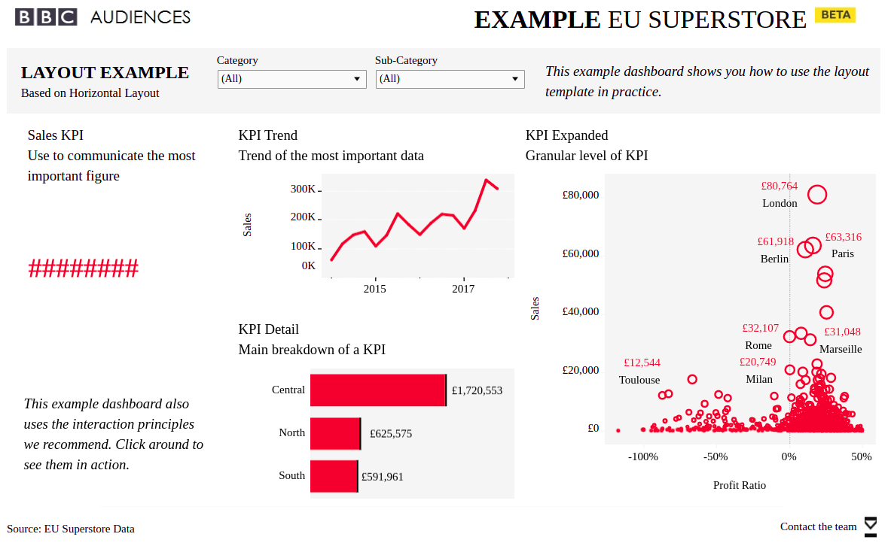
https://public.tableau.com/views/BBCAudiencesTableauStyleGuide/LayoutLogic?%3Aembed=y&%3AshowVizHome=no&%3Adisplay_count=y&%3Adisplay_static_image=y

Slide 35
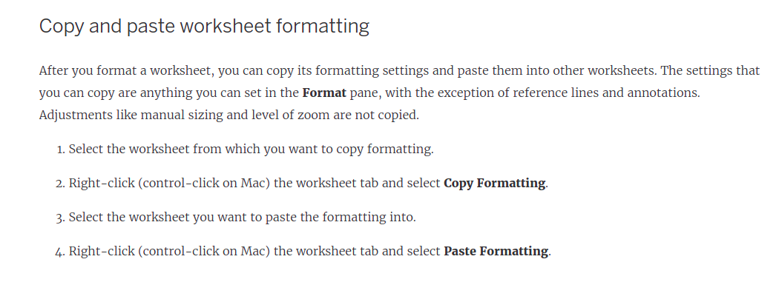
Formatting
https://help.tableau.com/current/pro/desktop/en-us/formatting_worksheet.htm#Copy_and_paste_worksheet_formatting
https://help.tableau.com/current/pro/desktop/en-us/formatting_worksheet.htm#Copy_and_paste_worksheet_formatting

Slide 36

Want to learn more?
https://www.youtube.com/watch?v=96371LvULXM&list=PLRfaJ7ZL0cF5ByWSGPFbzdijOx0mv73TY

Slide 37
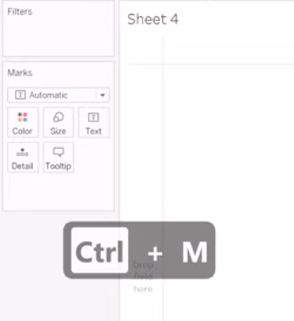
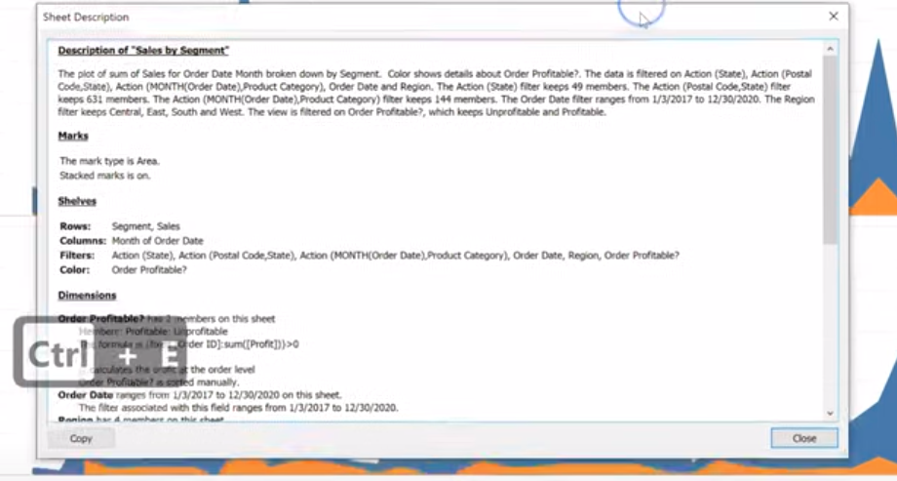
Tableau keyboard shortcuts
Try on a fancy worksheet from tableau public viz of day

Slide 38
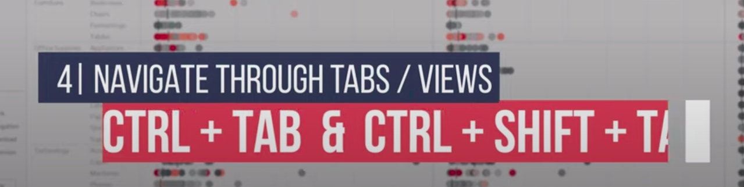
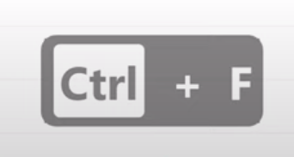

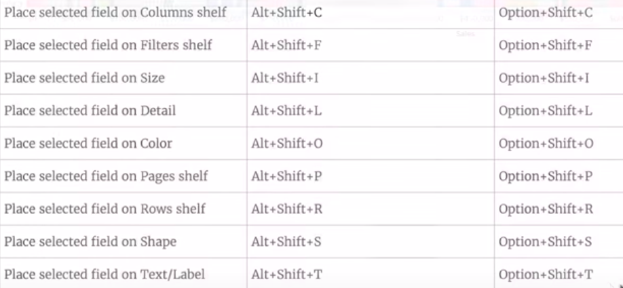
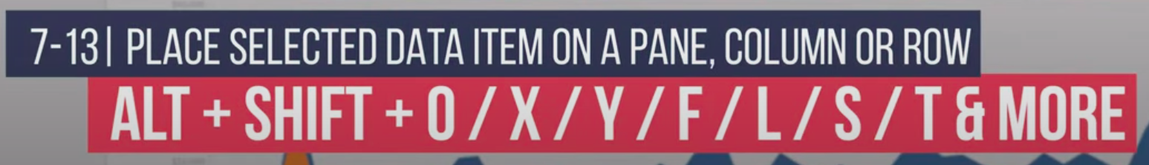
More shortcuts
Calculated
field?
https://help.tableau.com/current/pro/desktop/en-us/shortcut.htm#shortcuts-for-managing-workbooks-sheets-and-files-tableau-desktop

Slide 39
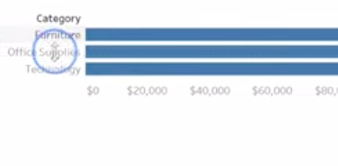
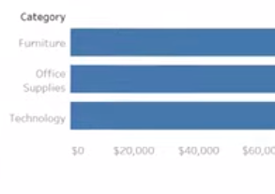
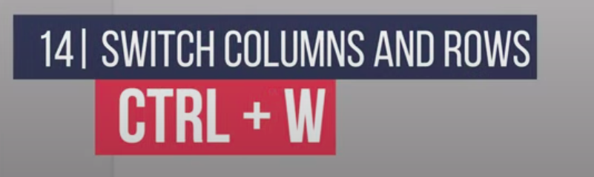
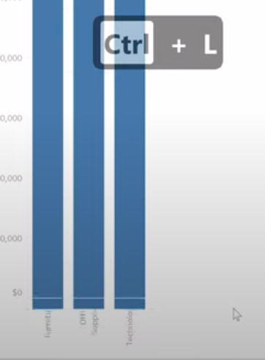
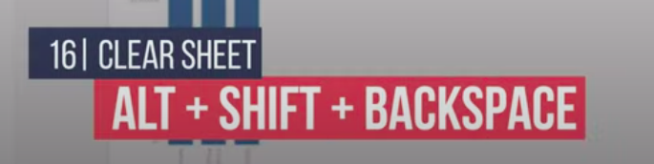

Slide 40
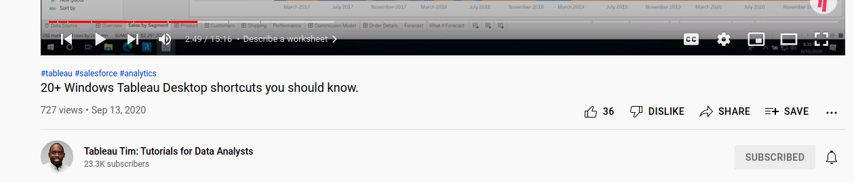
Want to learn more?
https://www.youtube.com/watch?v=xRTzYyfSyDo&list=PLRfaJ7ZL0cF7U9cR7ORuueqxItw3qcno1

Slide 41


Slide 42


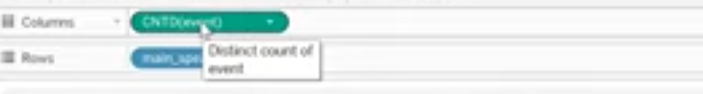
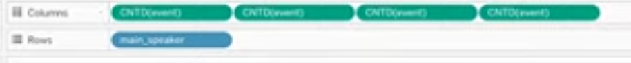
More shortcuts

Slide 43
Text tables with multiple measures
Just double click the measure

Slide 44
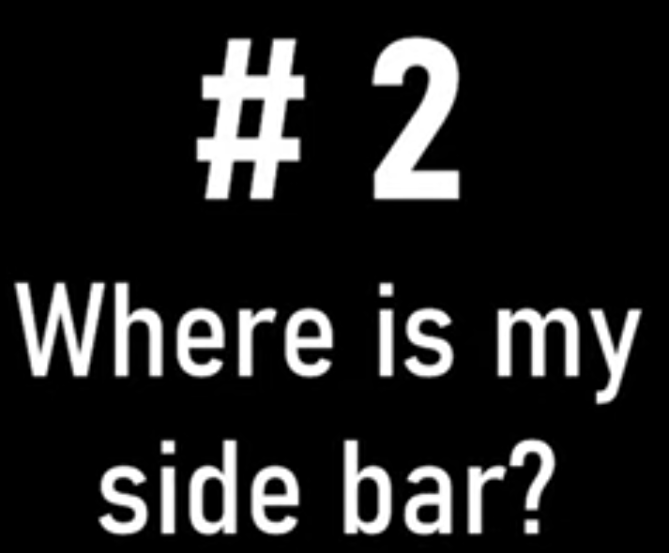

Slide 45
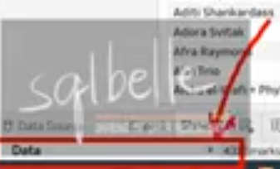
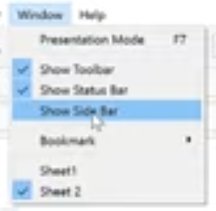

Slide 46

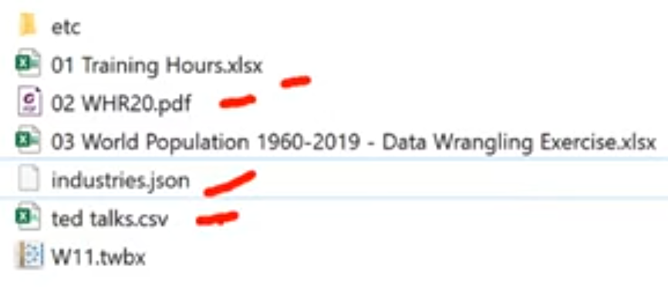
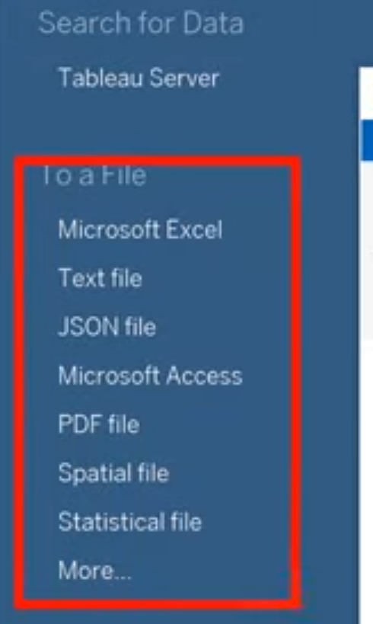

Drag!
Tableau will figure out the type of your file.

Slide 47
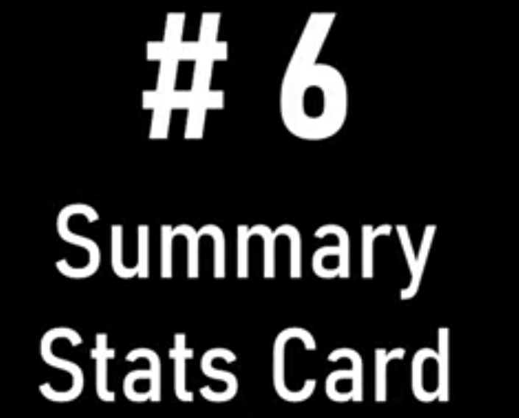
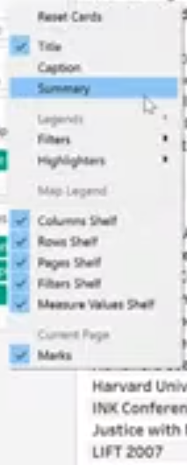
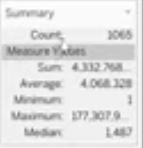
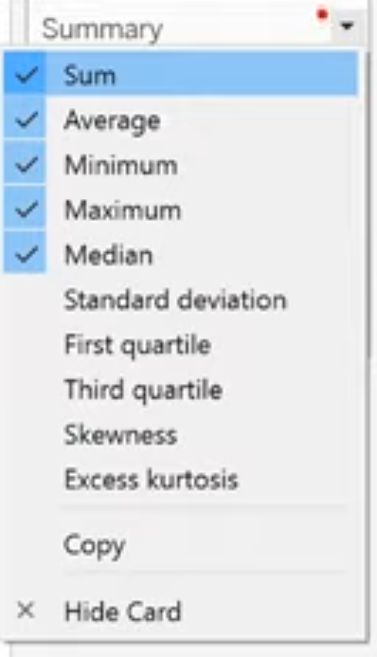

Slide 48

Want to learn more?
Add the link to the repo

Slide 49
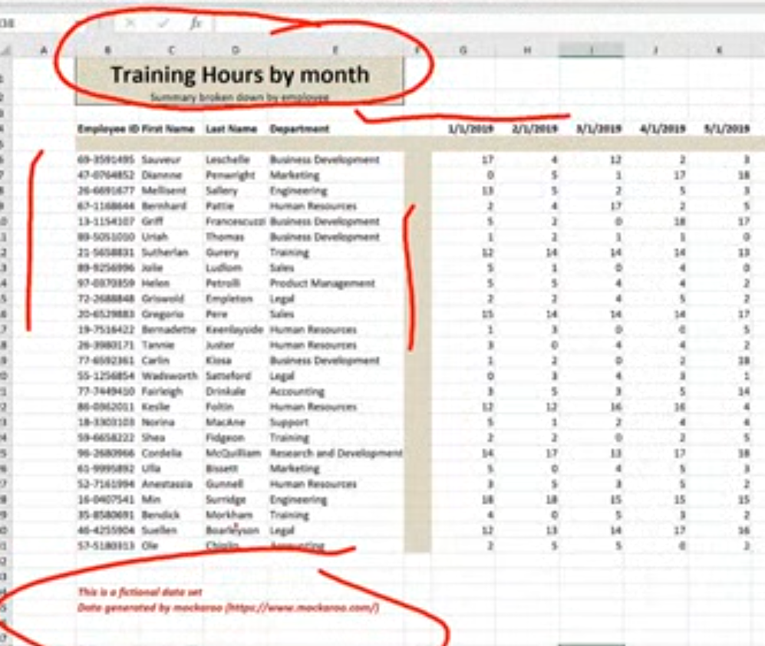
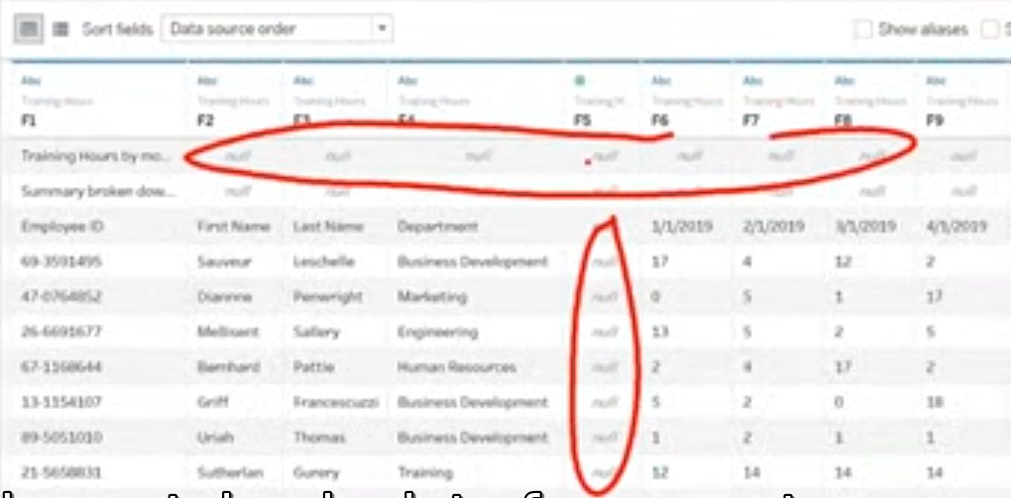

Slide 50



solution

Slide 51




Slide 52





Slide 53



Slide 54


Slide 55





Slide 56

Want to learn more?

Slide 57





Slide 58



Add or remove subtotals
Remember to double click

Slide 59






Different aggregation

Slide 60






Slide 61






Slide 62

Notes:
https://www.youtube.com/c/sqlbelle/search?query=tips

Slide 63


Slide 64

https://www.youtube.com/watch?v=U7w1XumKK60&list=PLT0KU4DMyMtGdtsHmsGCrY9nRurA1UeER&index=2

Slide 65
Sets can’t be created from tableau online
Dialog box not appearing

Slide 66

Possible errata
I think Last answer should not be marked. In solution, it is marked

Slide 67



seaborn
Is it different?
https://seaborn.pydata.org/whatsnew.html
Notes:
<number>

Slide 68

Scatter plot repo

Slide 69


facetgrid

Slide 70
facetgrid repo

Slide 71


Discuss how to choose palette?
When to choose each of these?
Notes:
Choosing color palettes — seaborn 0.11.1 documentation
https://seaborn.pydata.org/tutorial/color_palettes.html
The most important function for working with color palettes is, aptly, color_palette(). This function provides an interface to most of the possible ways that one can generate color palettes in seaborn. And it’s used internally by any function that has a palette argument.
<number>

Slide 72

Vary hue to distinguish categories

Slide 73

Vary hue to distinguish categories
Notes:
Most people would be able to quickly ascertain that there are five distinct categories in the plot on the left and, if asked to characterize the “blue” points, would be able to do so.
<number>

Slide 74

Vary luminance to represent numbers¶
Notes:
With the hue-based palette, it’s quite difficult to ascertain the shape of the bivariate distribution. In contrast, the luminance palette makes it much more clear that there are two prominant peaks.
<number>

Slide 75
How to choose color palettes?
qualitative palettes
sequential palettes
diverging palettes

Slide 76



Qualitative color palettes

Slide 77




Sequential color palettes
lines and points?
Heatmaps?
Notes:
Some seaborn functions will default to a sequential palette when you are mapping numeric data. (For historical reasons, both categorical and numeric mappings are specified with the hue parameter in functions like relplot() or displot(), even though numeric mappings use color palettes with relatively little hue variation).
Perceptually uniform palettes
Because they are intended to represent numeric values, the best sequential palettes will be perceptually uniform, meaning that the relative discriminability of two colors is proportional to the difference between the corresponding data values.
Which one can be used for lines and plots?
Which can be used for heatmaps?
Left for heatmaps (colors approaching white would be useful for very low values – but they can’t map points or lines on a background)
<number>

Slide 78


Matplotlib – and reverse!
Notes:
It is also possible to use the perceptually uniform colormaps provided by matplotlib, such as "magma" and "viridis":
As with the convention in matplotlib, every continuous colormap has a reversed version, which has the suffix "_r":
<number>

Slide 79

Sequential Color Brewer palettes

Slide 80

Diverging color palettes
When to use?
Notes:
Seaborn includes two perceptually uniform diverging palettes: "vlag" and "icefire". They both use blue and red at their poles, which many intuitively processes as “cold” and “hot”:
<number>

Slide 81


Diverging palettes

Slide 82

Can seaborn offer something here?
Also what’s the difference
between pairgrid and pairplot?
Notes:
Check the video for Kimberly
<number>

Slide 83


Ofcourse

Slide 84
pairgrid repo

Slide 85
Project
visualization
exploratory
quick
Not clean
explanatory
polished
Makes sense
Notes:
<number>

Slide 86
Choose dataset
Explore Your Data
Document your Story
Create your Slide Deck
Review and Submit the Project
Notes:
<number>

Slide 87

Plotly
https://nbviewer.jupyter.org/github/plotly/plotly_express/blob/gh-pages/walkthrough.ipynb

Slide 88

Other side
Notes:
Plotly Express: the Good, the Bad, and the Ugly | by Reilly Meinert | Towards Data Science
https://towardsdatascience.com/plotly-express-the-good-the-bad-and-the-ugly-dc941649687c
<number>

Slide 89

Dtale
https://www.analyticsvidhya.com/blog/2021/06/exploring-pandas-dataframe-with-d-tale/
http://alphatechadmin.pythonanywhere.com/dtale/main/1

Slide 90
Breakout 1
https://www.kaggle.com/alexisbcook/scatter-plots

Slide 91

Advanced task
https://projects.datacamp.com/projects/441

